Slide 1
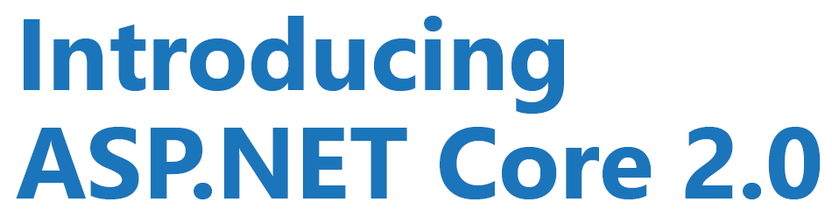
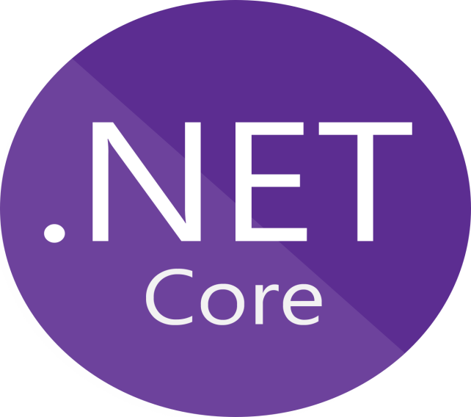
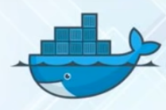
By : Vishal Garg

Slide 2

What is .NET Core?
Features of .NET Core?
Installation
Using CLI
Startup and Configuration
Managing Middleware
Tag Helpers
Demo

Slide 3
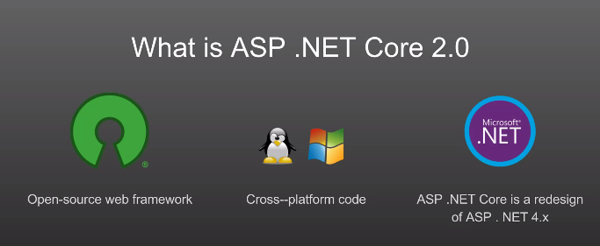
What is .Net Core?
.NET Core is a free, open-source framework for building modern, scalable, and high-performance cross-platform software applications.
Run on any platform like Windows, Linux, and MacOS.
Versions: 1.0, 1.1 , 2.0, 2.1, 2.2

Slide 4
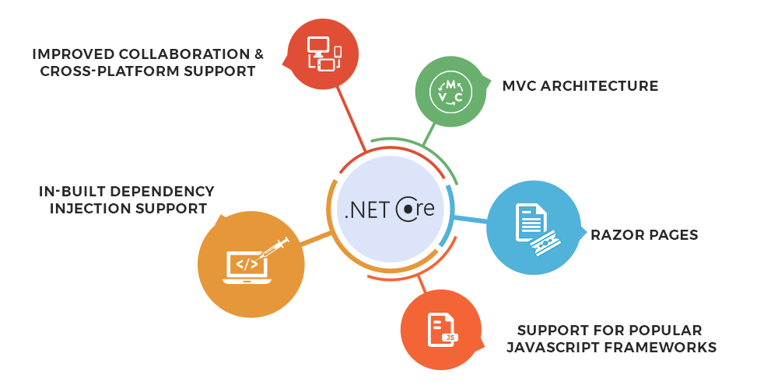
Features of .NET Core?
Free and Open Source.
Cross-platform.
Container Support
High performance
Multiple environments mode
Dependency Injection

Slide 5
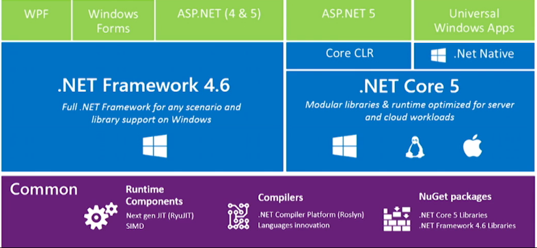
Difference
Features | .NET Framework | .NET Core
High-performance | - | Faster
Docker containers support | - | Better
Command Line | - | Better
Cross – Platform | No | Yes
Pre - Configured | Better | -
Open Source | No | Yes
Future | - | Better

Slide 6
Installation
To develop ASP.NET Core application, the following must be installed in your system:
.NET Core SDK
Integrated Development Environment (IDE)
Go to https://www.microsoft.com/net/core and select the platform you are using.
You can develop, restore, build and run .NET Core application either with Visual Studio or with command line interface for .NET Core.

Slide 7
CLI
The .NET Core command-line interface (CLI) is a new cross-platform tool for creating, restoring packages, building, running and publishing .NET applications.
The following is a command structure :-
dotnet <command> <argument> <option>
E.g:-
dotnet new console
dotnet build
dotnet run
dotnet new mvc

Slide 8
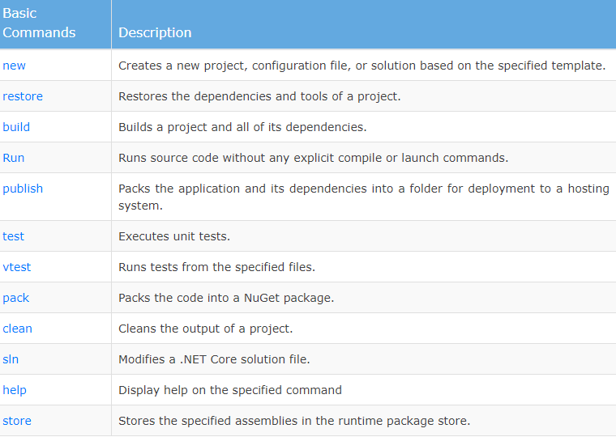
CLI

Slide 9
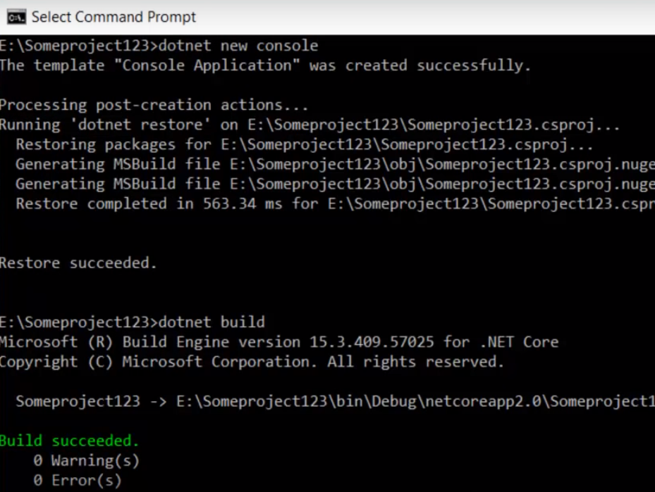
CLI

Slide 10
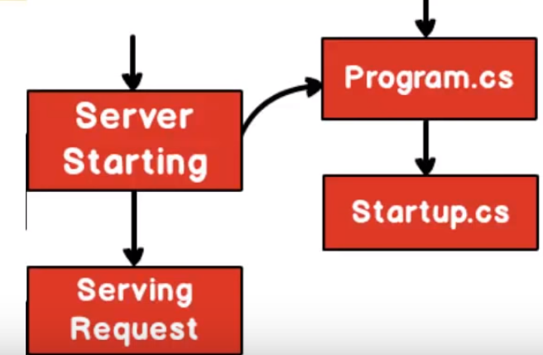
Structure
Server starting :- Loads application,services,cache
Serving request :- starts serving the request

Slide 11
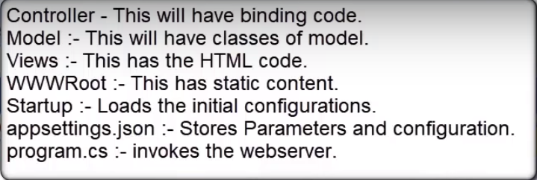
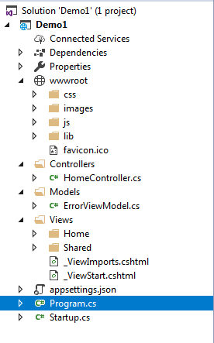
Structure

Slide 12
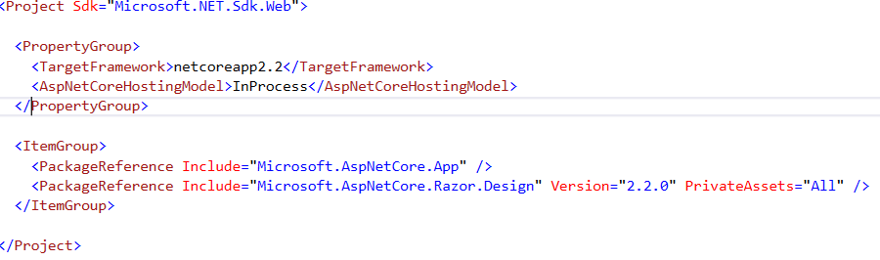
Structure
.csproj file
3 components :-
1.
2.
3.

Slide 13
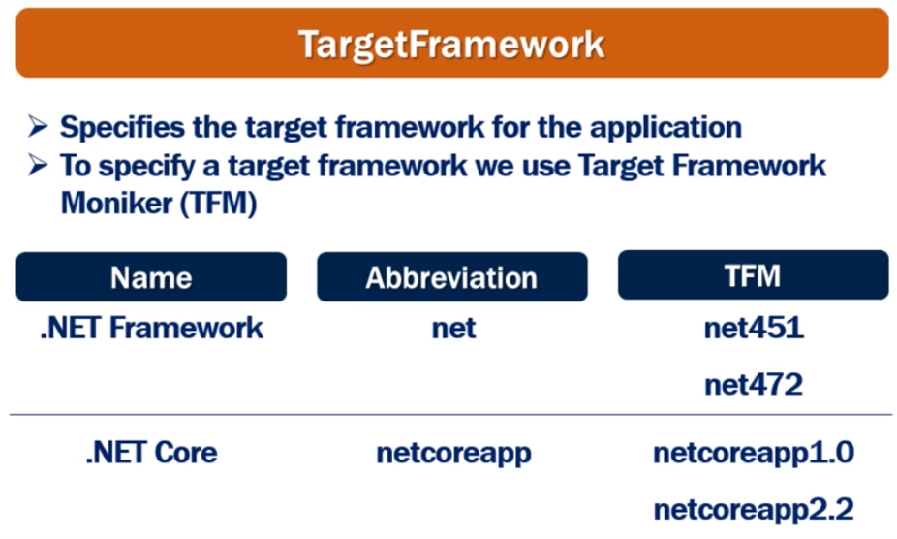
Structure

Slide 14
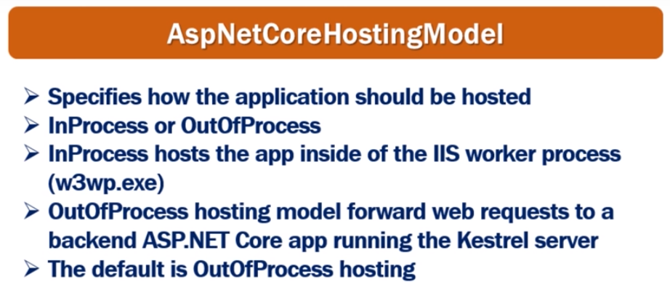
Structure
Core application can be hosted: -
InProcess or
OutOfProcess

Slide 15
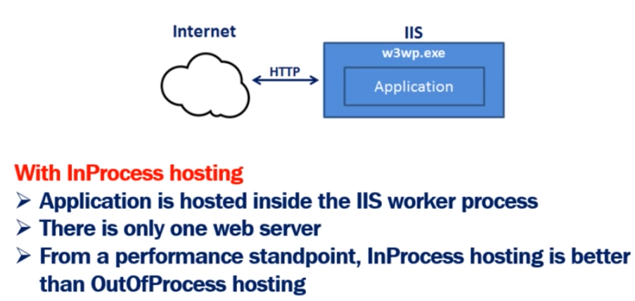
InProcess Hosting
Demo:- Core_HostProcess

Slide 16
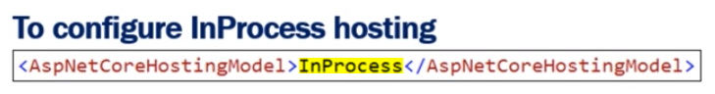
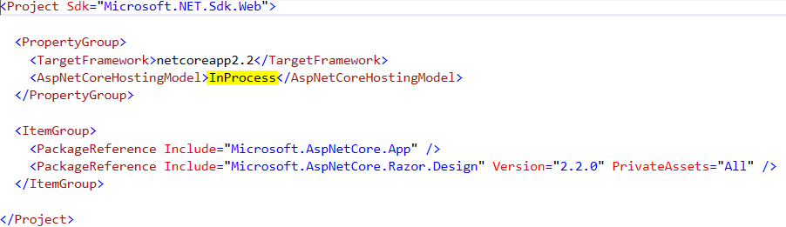
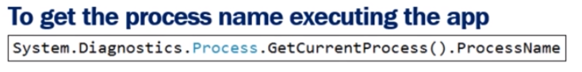
InProcess Hosting
Demo:- Core_HostProcess

Slide 17
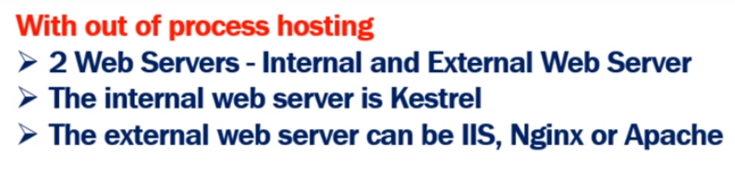
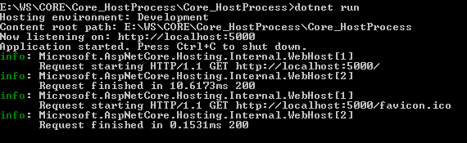
OutOfProcess Hosting
CLI :- Kestrel server is used
Demo:- Core_HostProcess

Slide 18

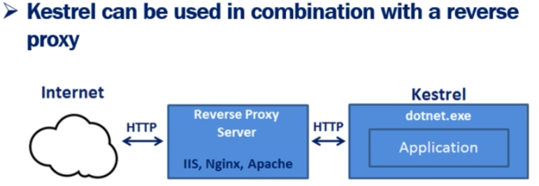
Kestrel Server
Demo:- Core_HostProcess

Slide 19
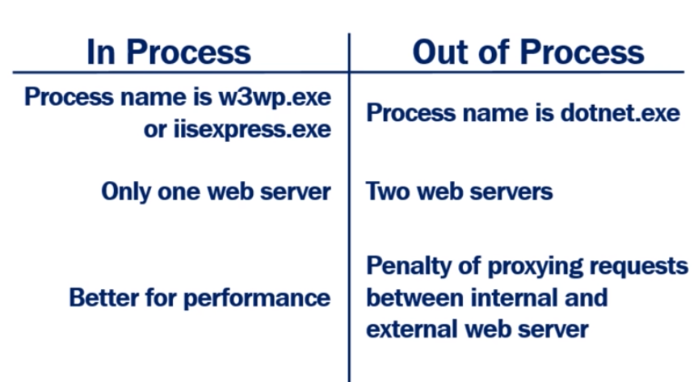
InProcess VS OutOfProcess
Demo:- Core_HostProcess

Slide 20
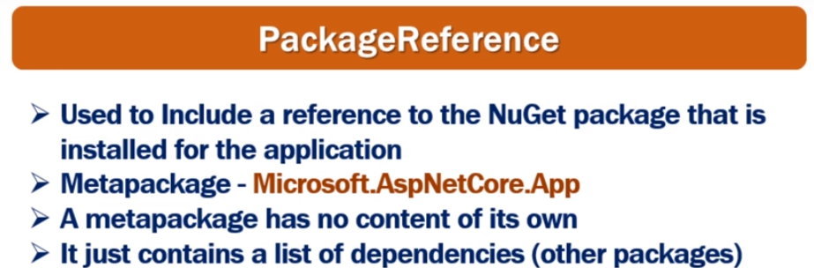
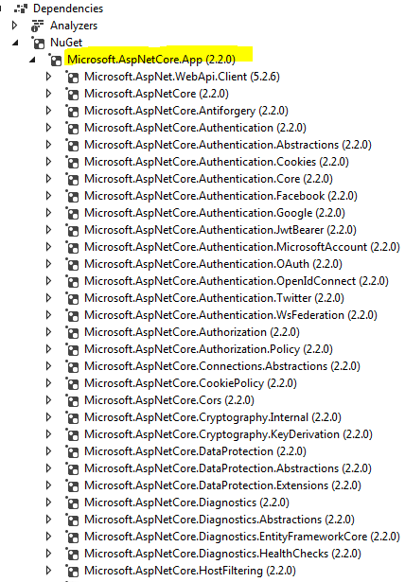

Slide 21
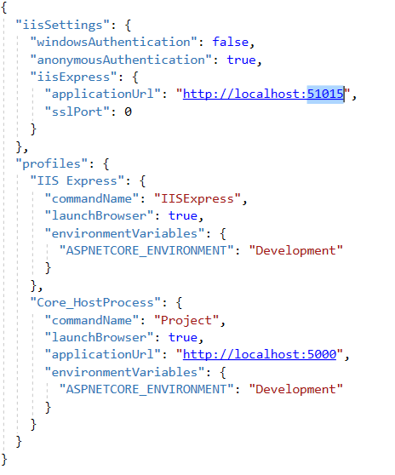
LaunchSettings.json
Demo:- Core_HostProcess

Slide 22
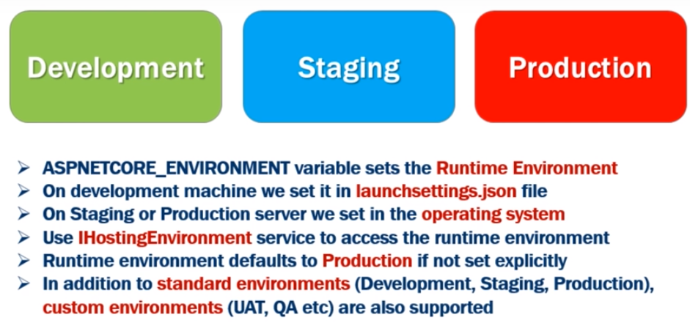
Development Environments
Demo:- Core_HostProcess

Slide 23

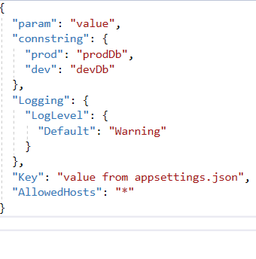
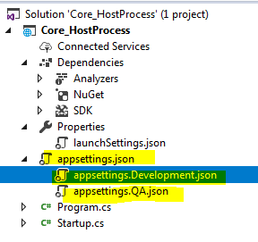
AppSettings.json
Configuration Order :-
appSettings.json
appSettings.{Environment}.json
Environment variables
Command – Line
Override
Demo:- Core_HostProcess

Slide 24
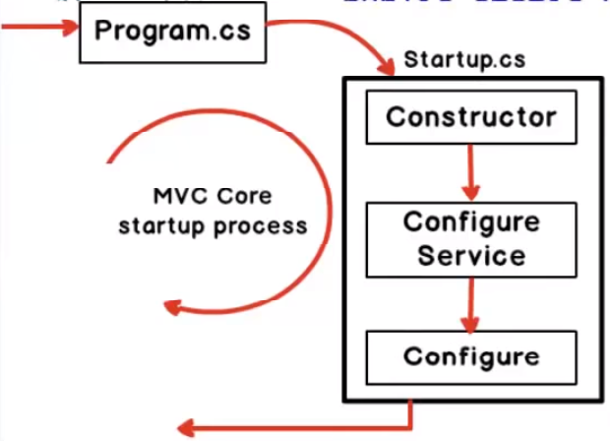
Structure

Slide 25
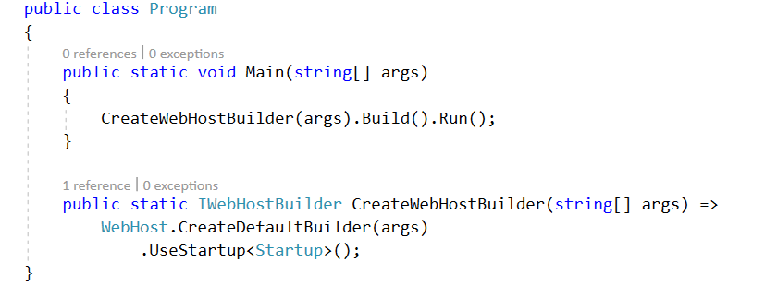
Program.cs
Program's is the first thing which runs in application
It does 2 things :-
1. It starts the web server (Kestrel server) and loads various configuration settings
2. It invokes startup.cs file.

Slide 26
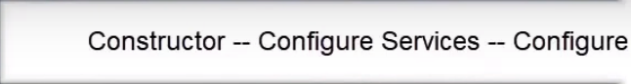
startup.cs
It does 3 things :-
1. Loads a configuration
2. Add services
3.Configure services
Plug and play model
we can pick and choose services

Slide 27
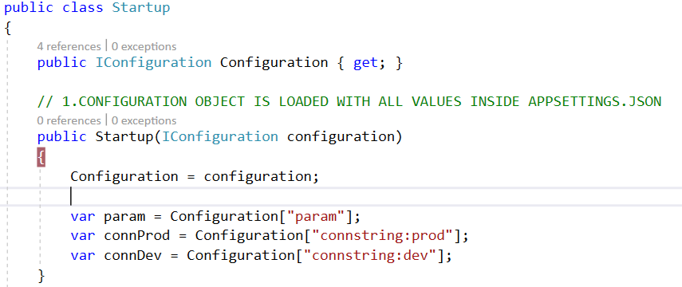
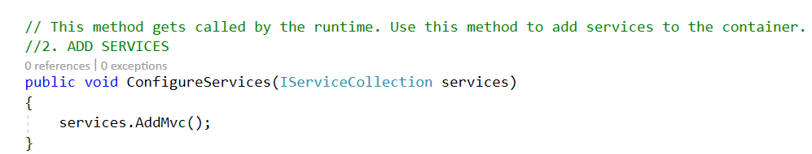
startup.cs

Slide 28
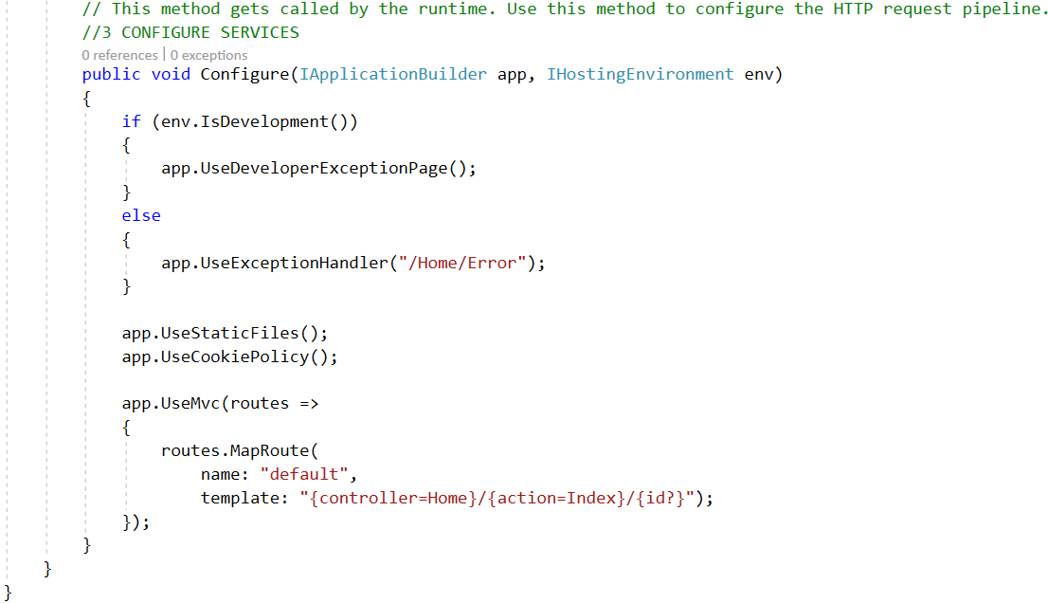
startup.cs
Example : - Core_HostProcess

Slide 29
Middleware
Pieces of code that handle requests and responses.
Middleware are chained to each other to form a pipeline
Middleware can do all sort of things, such as handling authentication, errors, static files, etc…
We can set the order of middleware execution in the request pipeline
Executed in order they are added
Memory and performance

Slide 30
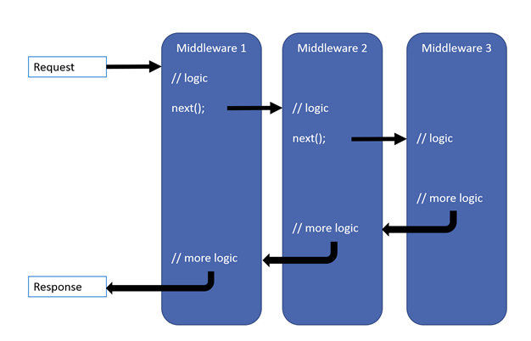
Middleware Pipeline

Slide 31
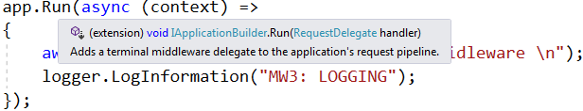
Short circuiting middleware
A middleware doesn’t necessarily have to call the next middleware.
Terminal middleware : -
Doesn’t call next middleware
app.Run(context)
To call next middleware : app.Use(context,next)
Call next middleware

Slide 32
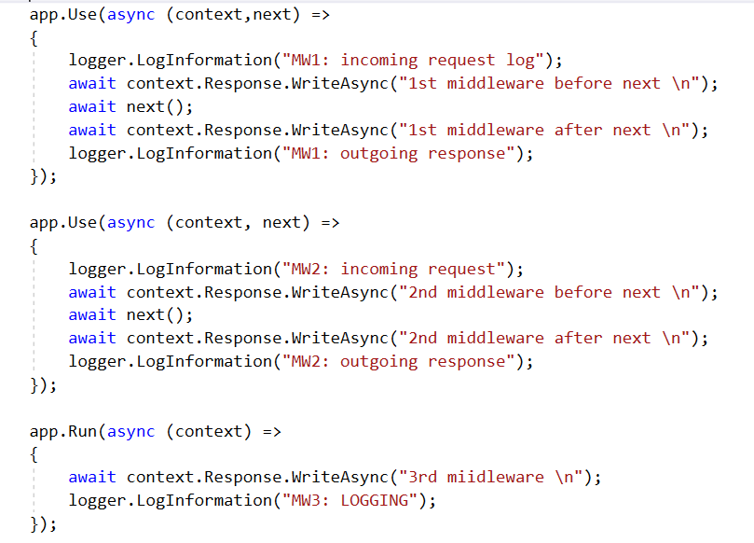
Middleware Example
Demo : - Core_Middleware

Slide 33
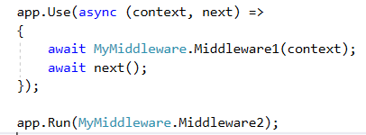
Middleware
We can also create our Custom Middleware's
Demo : - Core_Middleware > Custom_Middleware

Slide 34
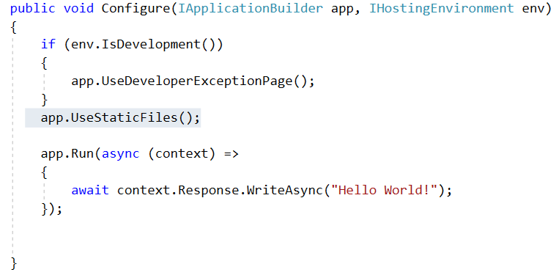
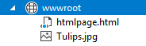
Built-In Middlewares(UseStaticFiles)
UseStaticFiles :- used to enable static files, such as HTML, JavaScript, CSS and graphics files.
1) Add Middleware :- UseStaticFiles()
2)Static content in”wwwroot” folder.
Demo : - Core_Staticfiles

Slide 35
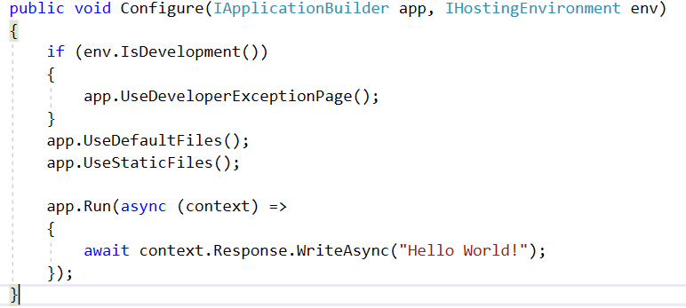
Built-In Middlewares (UseDefaultFiles)
UseDefaultFiles :- used to enable default files, such as HTML files.
1) Add Middleware :- UseDefaultFiles()
2)Static content in”wwwroot” folder.
Demo : - Core_Staticfiles

Slide 36
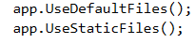
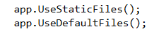
Built-In Middlewares
Ordering of Middleware's should be taken care of
Demo : - Core_Staticfiles

Slide 37
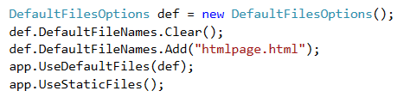
Built-In Middlewares
Set any other file as default file apart from “Default.html”
DefaultFileOptions :- used to set default files
Demo : - Core_Staticfiles

Slide 38
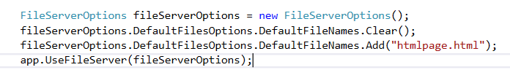
Built-In Middlewares (UseFileServer)
UseFileServer:- used to enable default and static files, such as HTML, JavaScript, CSS and graphics files.
Middleware :- UseFileServer()
UseDefaultFiles()
UseStaticFiles()
Demo : - Core_Staticfiles

Slide 39
Built-In Middlewares
Naming Convention :- <Use><MiddlewareName>();
E.g:- UseFileServer();
To customize Middleware options :-
<MiddlewareName><Options>
E.g:- FileServerOptions
DefaultFilesOptions
Demo : - Core_Staticfiles

Slide 40
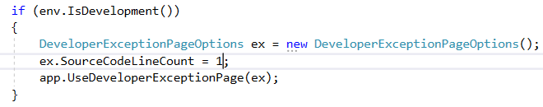
Built-In Middlewares
UseDeveloperExceptionPage :- used to display exception details like stack trace, query string, cookies etc..
Should be Plugged in pipeline as early as possible
Demo : - Core_Staticfiles

Slide 41
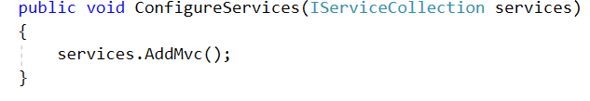
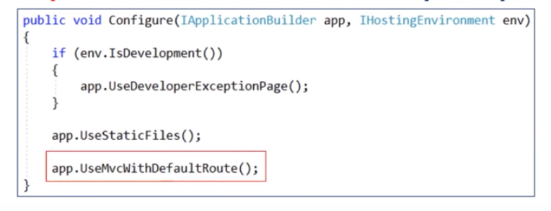
Setup MVC in ASP.NET CORE
2 steps : -
1 ) Add MVC services
2) Add MVC Middleware
Demo :- core_MVC_Setup

Slide 42
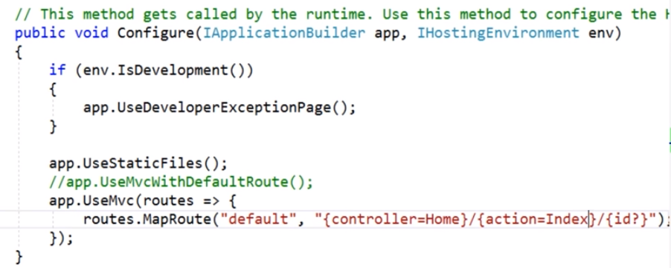
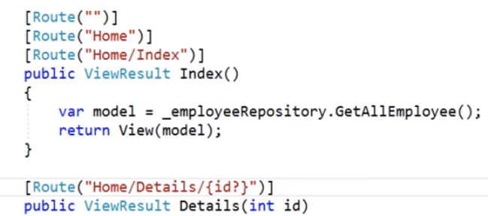
Routing
Attribute routing :-

Slide 43
Tag helpers
Creating and rendering HTML elements in Razor files
Built-in Tag Helpers :- forms, labels etc.
Tag Helpers reduce the explicit transitions between HTML and C# in Razor views.
Import <TAG HELPERS> :-
@addTageHelper :- Directive
* :- All Tag helpers
Microsoft.AspNetCore.Mvc.TagHelpers :- Assembly name
Demo :- core_MVC_Setup

Slide 44
Tag helpers
Some <Tag Helpers> examples :-
<LINK Tag Helper>
<FORM Tag Helper>
<LABEL Tag Helper>
<INPUT Tag Helper>
<LIST Tag Helper>
<VALIDATION Tag Helper>
Demo :- core_MVC_Setup

Slide 45

Demo :- core_MVC_Setup

Slide 46

.Net Core Dependency Injection
Loose Coupling
Easy to Test
Dependency Lifetimes : -
AddTransient – Created every time they are requested
AddScoped – Created once per request(scope).
AddSingleton – Created only for the first request
Demo :- core_DI

Slide 47

Exception Handling
Add Exception handling middleware
Demo : - Core_Exception_handling

Slide 48


Logging
Instance an instance of ILogger
Demo : - Core_Exception_handling

Slide 49
Publish cross-platform .NET app
.NET Core application deployment options : -
framework-dependent applications
self-contained applications.
framework-dependent 1.Net core framework required 2. Run on any O.S without any modifications | self-contained 1.App contains everything(not req.) 2. need to publish an OS-specific version
Example : -
1.Core_FrameworkDependantApp
2. Core_Self-contained app

Slide 50
Docker

Slide 51

Why we need Docker?

Slide 52


What is Docker ?

Slide 53

Docker - Flow ?

Slide 54
Docker – Key points
Light-weight : Application and its dependencies are packaged together
Cross-platform: Can be easily executed on any machine, irrespective of their host OS/ configurations.
Docker has to be installed to run the application residing in the container.

Slide 55
Docker – Commands
docker-compose build
docker images
docker run <your_image_id>
docker ps –a
docker inspect <your_container_id>
docker version

Slide 56

Docker – Installation
https://docs.docker.com/toolbox/toolbox_install_windows/
https://github.com/docker/toolbox/releases
Demo

Slide 57


Slide 58


Slide 59


